Slide 1
Quantitative Parlamentsforschung mit R
Theoretischer Hintergrund und Fragestellungen

Slide 2
Übersicht
Logistik: Fragen und Probleme?
Theoretischer Hintergrund – Beispiele
Föderalismus und staatliche Performanz
Föderalismus und legislative Prozesse
Abstimmungsverhalten
Plenardebatten und Charakteristika der Parlamentarier:innen
Gruppendiskussion – Eigene Forschungsfragen

Slide 3
Föderalismus und Performanz I
Ehlert, Niek, Annika Hennl, and André Kaiser. 2007. “Föderalismus, Dezentralisierung Und Performanz. Eine Makroquantitative Analyse Der Leistungsfähigkeit Territorialer Politikorganisation in Entwickelten Demokratien.” Politische Vierteljahresschrift 48(2): 243–68.
„Does federalism matter?“ Wir leiten zunächst ein theoretisches Erklärungsmodell der Zusammenhänge zwischen Föderalismus, Dezentralisierung und Performanz aus der föderalismustheoretischen und der finanzwissenschaftlichen Literatur her und überprüfen dieses sodann mittels einer statistischen Analyse für die OECD-Staaten. Es zeigt sich, dass Föderalismus und Dezentralisierung nicht nur theoretisch, sondern auch empirisch als zwei unterschiedliche Dimensionen mit eigenem Erklärungspotenzial für die Ergebnisse von Staatshandeln aufgefasst werden müssen. Die theoretisch erwarteten positiven Effekte von Dezentralisierung und die tendenziell negativen Auswirkungen von Föderalismus werden im Wesentlichen bestätigt.

Slide 4
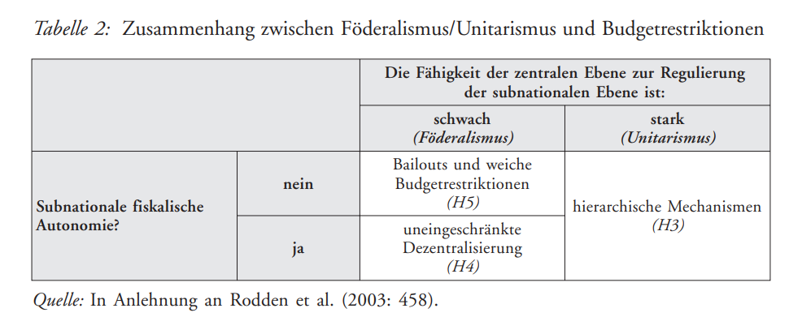
Föderalismus und Performanz II

Slide 5
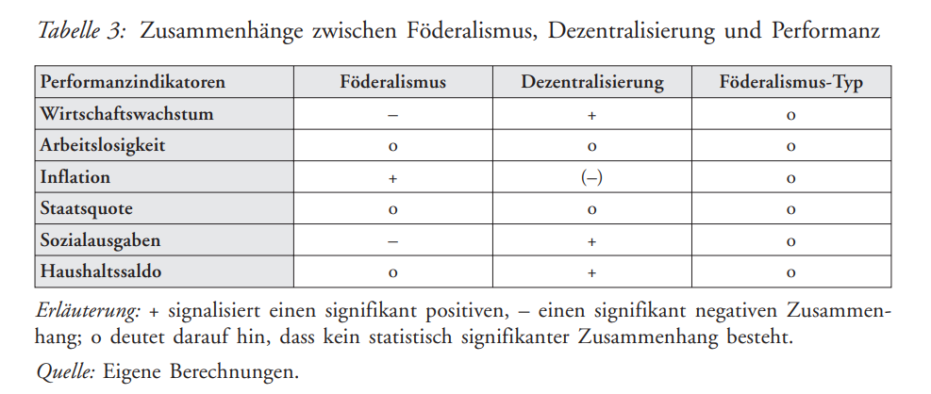
Föderalismus und Performanz III

Slide 6
Föderalismus und Pol. Prozesse
Stecker, Christian. 2016. “The Effects of Federalism Reform on the Legislative Process in Germany.” Regional and Federal Studies 26(5): 603–24.
When the reform of German federalism was enacted in 2006, the right of the second chamber, Bundesrat, to veto large parts of national legislation had long been identified as a dysfunctional element of the federal system. The need to compromise with an often opposition-controlled Bundesrat was perceived as hurting democratic principles and worsening Germany’s policy performance. Hence, a variety of constitutional amendments was adopted in 2006 to curb the veto threat. This paper sketches how the expansion of the Bundesrat veto emerged and how the reform tried to reduce it. Covering all federal legislation between 1978 and 2016 this paper then analyses the actual effects of the reform. It is shown that the veto threat has been reduced by around 17% but that it remains unchanged at around 65% in the area of tax law.

Slide 7
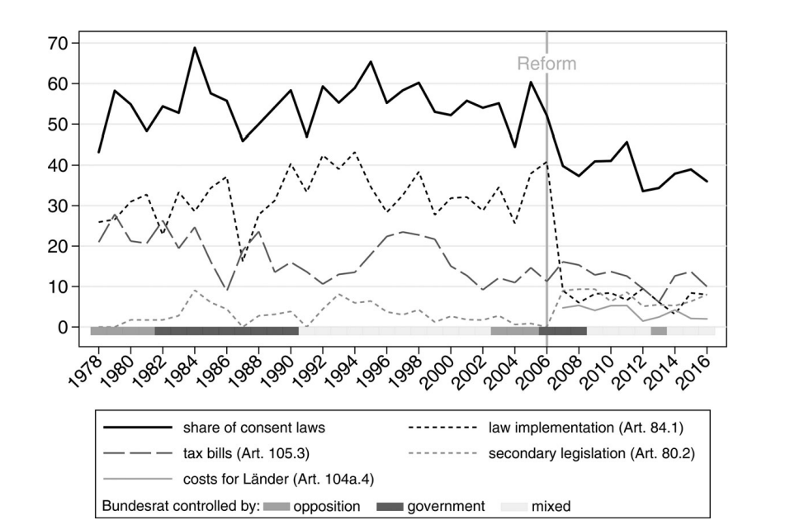
Föderalismus und Pol. Prozesse II

Slide 8
Abstimmungsverhalten I
Wenzelburger, G., & Fehrenz, S. (2018). Die Union und die „Ehe für Alle“. Bestimmungsfaktoren des Abstimmungsverhaltens in der CDU/CSU-Fraktion im Bundestag. Zeitschrift Für Parlamentsfragen, 49(3), 512–530
The study of legislative behavior, party cohesion, and discipline is an important body of research in the study of parliaments . The present article adds to this literature by zooming in on a specific case - the voting patterns of the members of parliament of the CDU/CSU in the German Bundestag on the bill of same-sex marriage . The parliamentary party had decided not to find agreement on that issue but leave the decision on this conscience issue to each MP . Hence, the vote on this bill allowed us to discover patterns of legislative behavior that are usually masked by the effect of party discipline . Including MPs’ individual demographics, for instance age or gender, as well as features of their electoral district, such as their voters’ church attendance, we find that older and married CDU/CSU-MPs from more religious and catholic electoral districts with a somewhat lower level of education were more likely to vote against the bill in question . These results show that MPs’ parliamentary voting behavior is driven by personal traits - at least when party discipline plays a less important role .

Slide 9
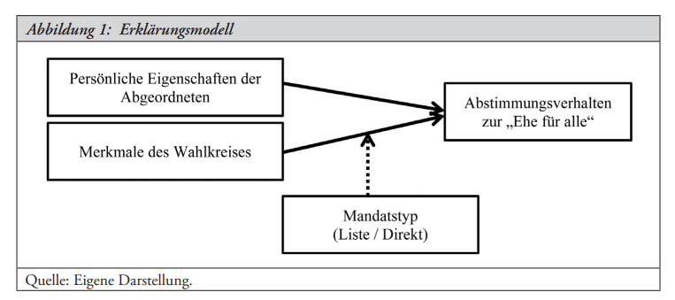
Abstimmungsverhalten II

Slide 10
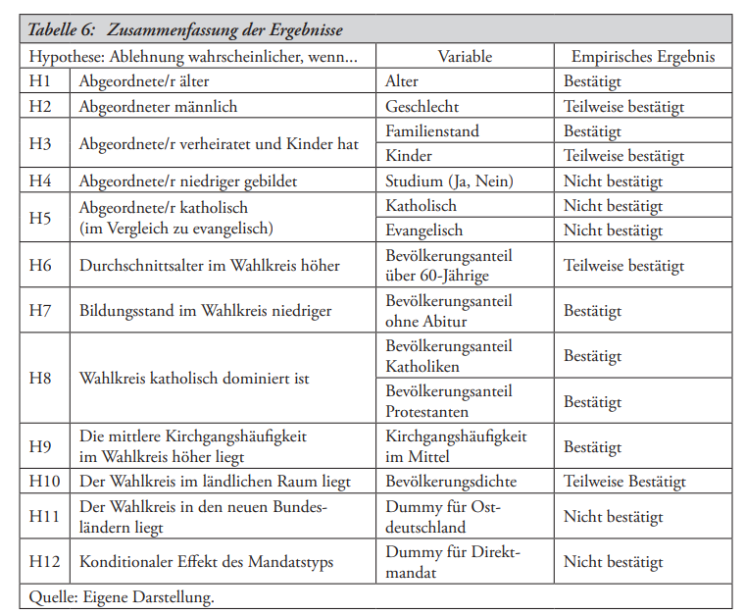
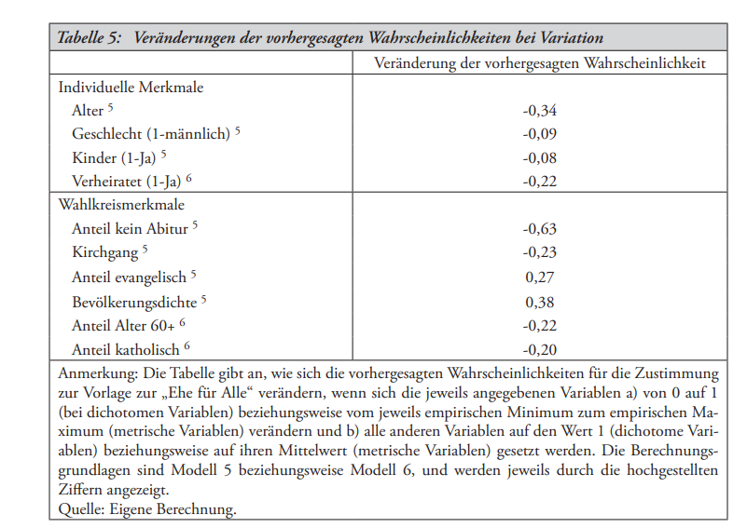
Abstimmungsverhalten III

Slide 11
Plenardebatten
Bäck, H., & Debus, M. (2020). Personalized versus partisan representation in the speeches of migrant members of parliament in the German Bundestag. Ethnic and Racial Studies, 43(9), 1673–1691. https://doi.org/10.1080/01419870.2019.1654112
Given the increasingly polarized debates in many modern democracies over migration and integration, the behaviour of members of parliament (MPs) with a migrant background has important implications for patterns of representation. Drawing on role congruity theory, we hypothesize that MPs with a migrant background deliver more legislative speeches in debates that are of interest for citizens with a migrant background. The findings, which are based on speeches delivered in the German Bundestag between 2009 and 2013, indicate that MPs of immigrant origin, in particular those MPs who have a “visible” migrant background, deliver significantly more speeches in debates focusing on civil rights. We also find that migrant MPs who are elected via the party list, as opposed to MPs who are directly elected in a district, are more likely to speak in debates on citizen and minority rights, suggesting that the parliamentary party leadership strategically selects migrant MPs as speakers in certain parliamentary debates.

Slide 12
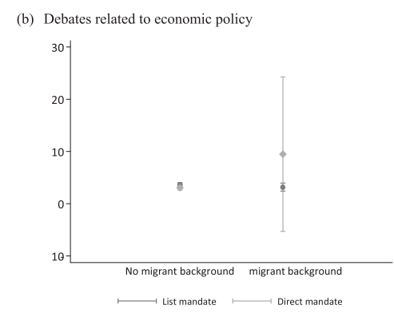
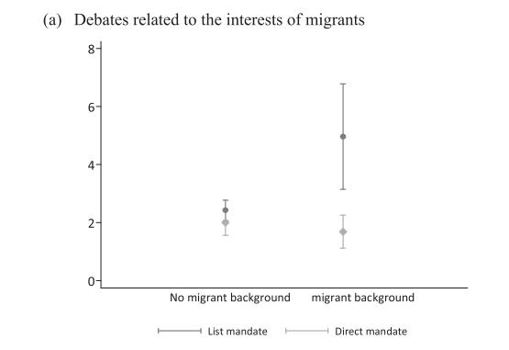
Plenardebatten II

Slide 13
Gruppendiskussion
Eindruck der Artikel
Eigene Fragestellungen/ Projekte
Methodische Ansätze – kann auch noch sehr undifferenziert sein.

